Slide 1
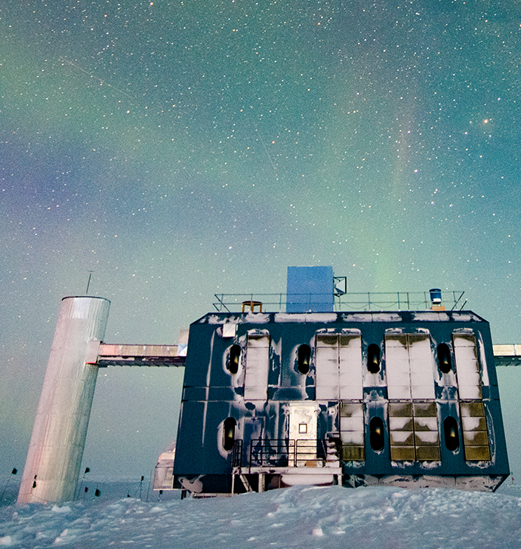
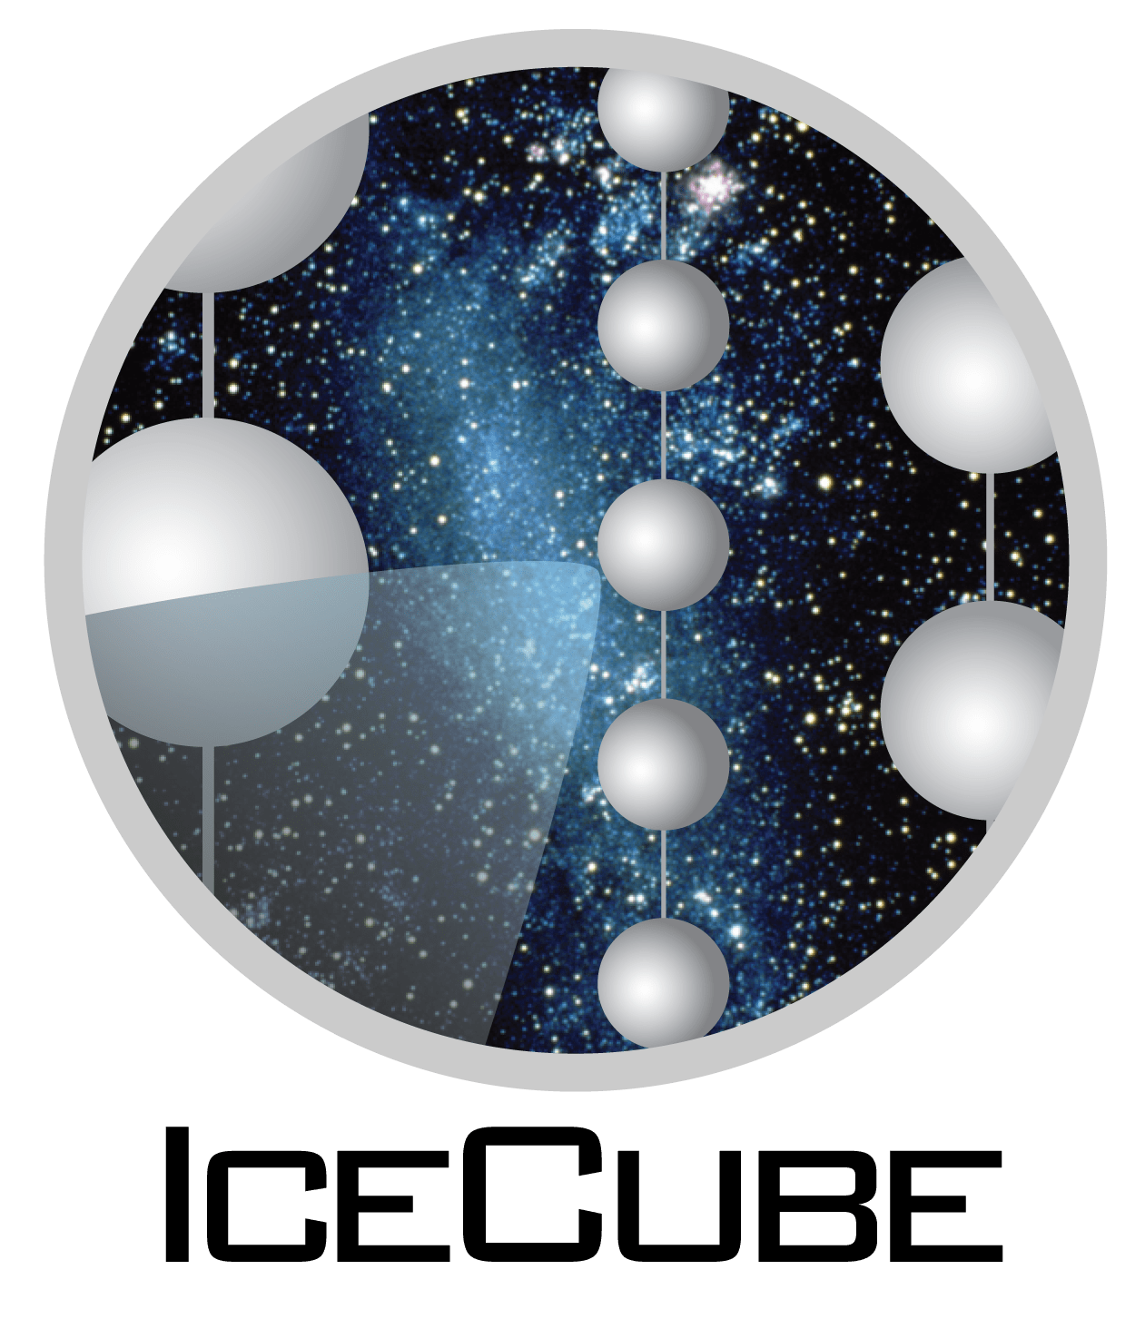
Muon deflection uncertainties on directional reconstructions using PROPOSAL
Pascal Gutjahr
TU Dortmund University
Collaboration Meeting Madison, 18-23 September 2022

Slide 2
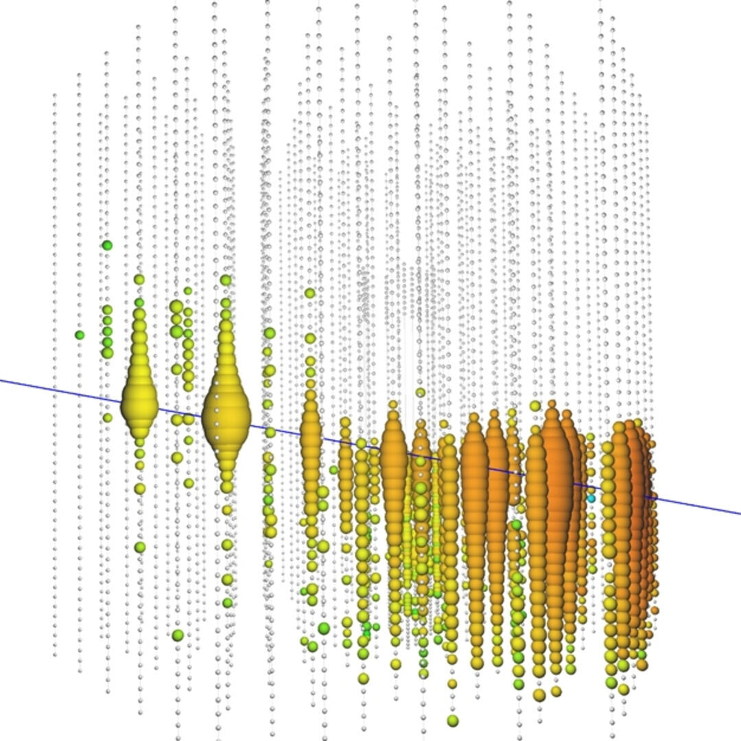
Motivation of muon deflection simulation
Why?
TeV to PeV muons are strongly forward boosted
Single deflection lower than angular resolution of ~0.6°
Assume muon propagation along a straight line
But:
Muons can propagate up to several km through media
Thousands of interactions
Large energy losses
Deflection in each interaction
What happens if thousands of deflections accumulate?
Is a total deflection on the order of magnitude of current angular resolutions possible?
https://www.rwth-aachen.de/cms/root/Die-RWTH/Aktuell/Pressemitteilungen/August/~isgx/Spektakulaer-hochenergetisches-kosmische/?lidx=1

Slide 3
Overview
Motivation of muon deflection simulation
Simulation tool PROPOSAL
Muon deflection per interaction
Comparison with other simulation tools
Data-MC checks
Estimate muon deflection uncertainty on angular reconstruction
Summary & outlook

Slide 4
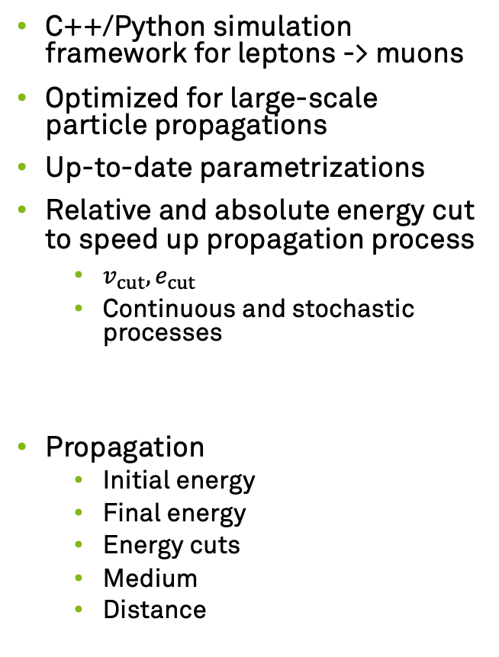
Simulation tool PROPOSAL
C++/Python simulation framework for leptons -> muons
Optimized for large-scale particle propagations
Up-to-date parametrizations
Relative and absolute energy cut to speed up propagation process
$v_{cut}, e_{cut}$
Continuous and stochastic processes
Propagation
Initial energy
Final energy
Energy cuts
Medium
Distance
Deflection
Multiple scattering
Molière
Highland
Stochastic deflection
Bremsstrahlung
Photonuclear interaction
Electron pair production
Ionization
Different parametrizations from Van Ginneken¹ and Geant4² are available
github.com/tudo-astroparticlephysics/PROPOSAL
github.com/icecube/icetray/tree/main/PROPOSAL
¹ NIM A251 (1986) 21-39
² geant4.web.cern.ch

Slide 5
Muon deflection per interaction
1000 muons propagated in ice
Initial energy 1 PeV
Final energy 1 TeV
e_cut = 500 MeV, v_cut = 0.05
Largest median deflection by photonuclear interaction
Largest outliers by bremsstrahlung
Highland – Gaussian approximation neglects outliers
Deflection dominated by multiple scattering
arXiv:2208.11902

Slide 6
Accumulated deflection
Single deflections extend over several order of magnitudes up to a few degrees
Muons do up to thousands of interactions
Question
Can all deflections along the muon propagation accumulate to a total deflection that impacts our angular resolution?
First, validate PROPOSAL results with other simulation tools and data

Slide 7
Comparison with other simulation tools
MUSIC¹
3D muon simulation code
Geant4²
Simulates passage of particles through matter very precisely, but intensive computing
Made for simulations in particle detectors
Good agreement in angular deflection
Small deviations in lateral displacement
Highland approximation neglects outliers
arXiv:2208.11902
1 Mio. muons are propagated from 2 TeV over a distance of 3 km in water
¹ Astropart. Phys. 7.4 (1997) 357-368
² geant4.web.cern.ch

Slide 8
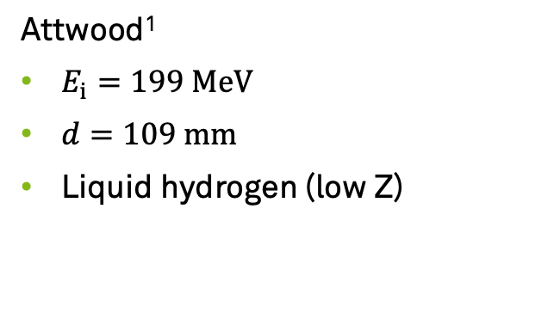
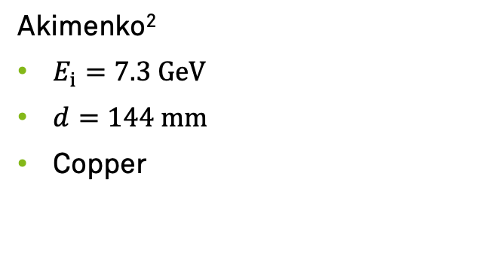
Data-MC checks
Attwood¹
$E_{i}=199 MeV$
$d=109 mm$
Liquid hydrogen (low Z)
Akimenko²
$E_{i}=7.3 GeV$
$d=144 mm$
Copper
arXiv:2208.11902
Good agreement in both measurements
¹ NIMB 251.1 (2006) 41-55
² NIMA 243 (1986) 518-522

Slide 9
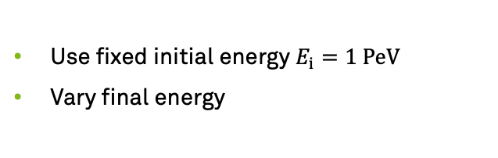
Accumulated deflection for several final muon energies
Use fixed initial energy $E_{i}=1 PeV$
Vary final energy
median with 95% content level → exponential fit
Deflection increases as final energy decreases
Check median deflection for different initial energies

Slide 10
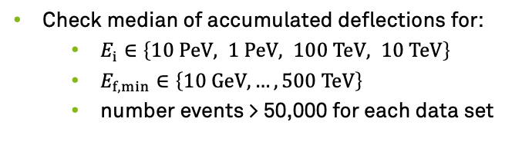
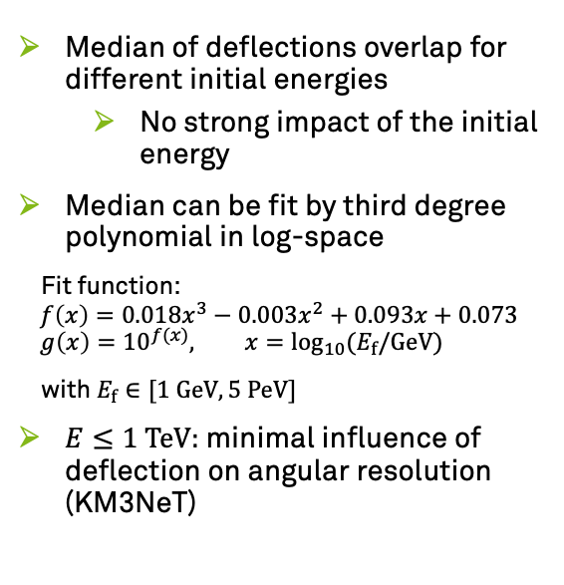
Accumulated deflection impact on angular resolutions
Check median of accumulated deflections for:
$E_{i}∈\left\{10 PeV, 1 PeV, 100 TeV, 10 TeV\right\}$
$E_{f,min}∈\left\{10 GeV, …,500 TeV\right\}$
number events > 50,000 for each data set
Median of deflections overlap for different initial energies
No strong impact of the initial energy
Median can be fit by third degree polynomial in log-space
Fit function:
$$f\left(x\right)=0.018x^{3}−0.003x^{2}+0.093x+0.073 \\ g\left(x\right)={10}^{f(x)}, x=\log_{10}{{(E}_{f}/GeV)}$$
with $E_{f}∈[1 GeV, 5 PeV]$
$E≤1 TeV:$ minimal influence of deflection on angular resolution (KM3NeT)
arXiv:2208.11902

Slide 11
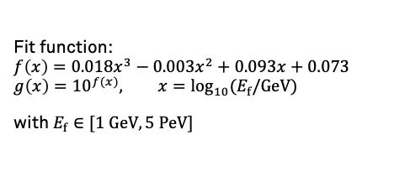
Estimate muon deflection uncertainty on angular reconstruction
No information about the muon before the detector entry
We can only reconstruct the muon at the detector entry
Energy
Direction
Detector entry energy = final muon energy
Muon deflection depends only on the final muon energy
Use reconstructed muon energy to estimate the muon deflection before the detector entry
Systematic uncertainty
Fit function:
$$f\left(x\right)=0.018x^{3}−0.003x^{2}+0.093x+0.073 \\ g\left(x\right)={10}^{f(x)}, x=\log_{10}{{(E}_{f}/GeV)}$$
with $E_{f}∈[1 GeV, 5 PeV]$

Slide 12
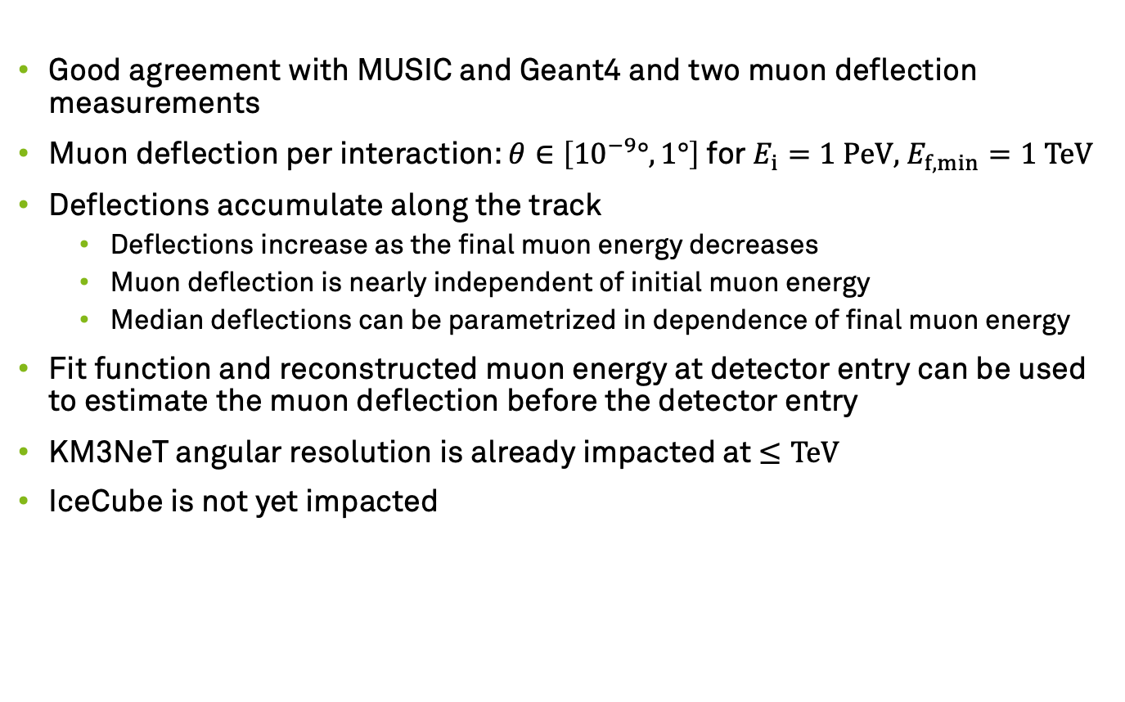
Summary
Good agreement with MUSIC and Geant4 and two muon deflection measurements
Muon deflection per interaction: $θ∈\left[{10}^{−9}°, 1°\right]$ for $E_{i}=1 PeV$, $E_{f,min}=1 TeV$
Deflections accumulate along the track
Deflections increase as the final muon energy decreases
Muon deflection is nearly independent of initial muon energy
Median deflections can be parametrized in dependence of final muon energy
Fit function and reconstructed muon energy at detector entry can be used to estimate the muon deflection before the detector entry
KM3NeT angular resolution is already impacted at $≤TeV$
IceCube is not yet impacted

Slide 13
Outlook
Paper submitted to EPJ C
Use PROPOSAL 7 in IceCube
Now: PROPOSAL 6 -> without stochastic deflection
Measure muon deflections at energies of TeV to PeV
Validate simulations at higher energies
IceCube Gen-2
Muon deflection becomes more relevant with further angular reconstruction improvements
Especially at energies lower than TeV (IceCube Upgrade)

Slide 14
Appendix – median deflection with different energy cuts
1 PeV to 1 TeV, 1000 events each, Molière, 95% Interval
Low cuts –> more stochastic propagation
Leads to lower deflections
Molière simulates larger deflections at higher energies
See Akimenko

Slide 15
Appendix – check deflection in dependence of propagation distance
3 data points per line
median ●, lower ▲ and upper ▼ bound 90% CL
using data within ± 10%
propagation distance depends on initial particle energy
deflection increases with propagation distance
deflection is similar for medians of propagation distance for different initial energies

Slide 16
Appendix – energy rescale to muon energy

Slide 17
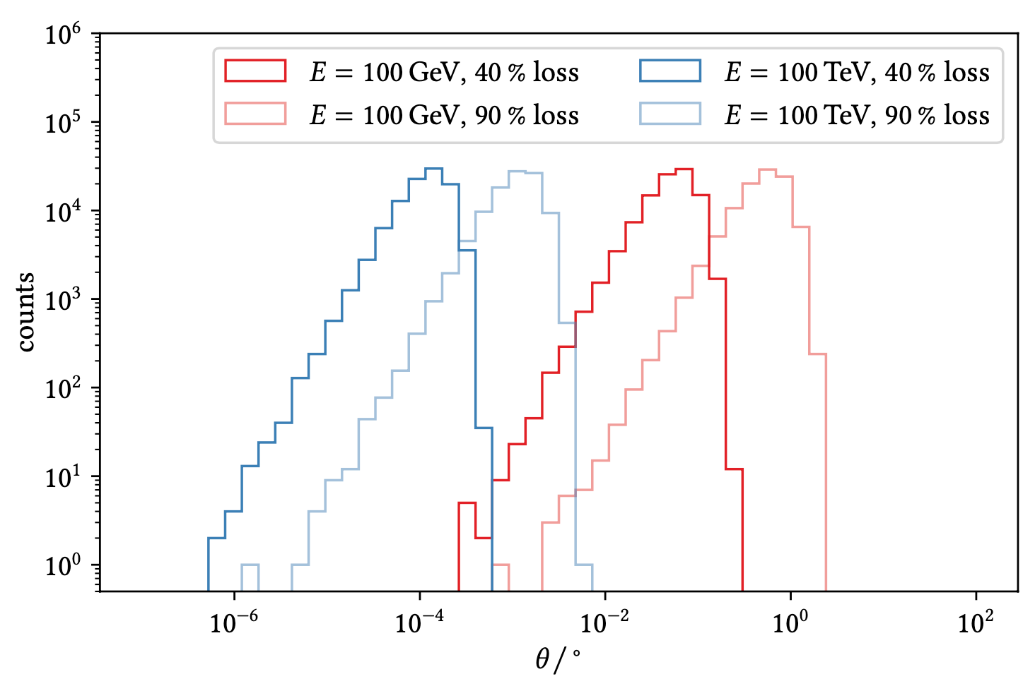
Electron pair production – Van Ginneken
Several orders of magnitude for fixed energy and energy loss

